Slide 1
…HELLO TNTs...
[Take a team picture to be posted in Teams]
Introduce your team to the other teams tomorrow

Slide 2
…HELLO MY NAME IS… …CHRISTELLE…
Created for Microsoft / TNT 2022

Slide 3


Slide 4
IMPORTANT LINK
https://github.com/tnt-summer-academy/Curriculum-2022/wiki
Created for Microsoft / TNT 2022

Slide 5
It is recorded!

Slide 6
Git / GitHub / Web Dev with React / JavaScript / Projects
What is it?
When we meet?
How it is organized?
Notes:
It is not à class!!!!

Slide 7
INTRO TO GIT AND LOCAL WORKFLOW
We are local!

Slide 8
Learning Objectives
TNTs will understand what is source control and why we need it
TNTs will learn how their previous code or doc collaboration experience maps to aspects of source control
TNTs will be able to work with a local repository using Git
TNTs will be able to work with and download a repository from GitHub
TNTs will understand that it’s normal to encounter problems while using git and start to develop strategies for dealing with problems

Slide 9
PART 0 IS GIT INSTALLED?
Open a terminal and type git

Slide 10
PART 1 SOURCE CONTROL AND YOU
10 minutes

Slide 11
Group exercise
Have you ever worked on a code project or a document with other people? How did you share your work? Google doc? Emailing? GitHub?
When working with other people on code or project, what has gone wrong? Have you gotten versions of the document mixed up? Have you lost changes? How was the collaboration?
Describe your experience and what you put in place to solve the issues

Slide 12
What is source control?
To manage your source code
To keep an history of your project
To facilitate collaboration on a project
To support large teams – 1000…
To try things without fear
It requires practice

Slide 13
Why is source control important?
Source code is a valuable asset
One of the most important things in a software company!
You need to protect it from
Physical damages / Theft of hard drives
Human errors
Malicious people
You will save a lot of time
Source control is the best way to synchronize multiple developers without wasting hours merging
It is a great tool when you need to find when a bug was introduced

Slide 14
Source control history
Source control systems have been around for decades now
CVS (1986), Subversion (2000), BitKeeper (2000), Mercurial (2005), Git (2005)
They evolved from centralized systems to distributed systems
Git is widely recognized as one of the best source control available today
and GitHub is the number one place to share code

Slide 15
PART 2 GIT BASICS AND BEST PRACTICES
5 minutes

Slide 16
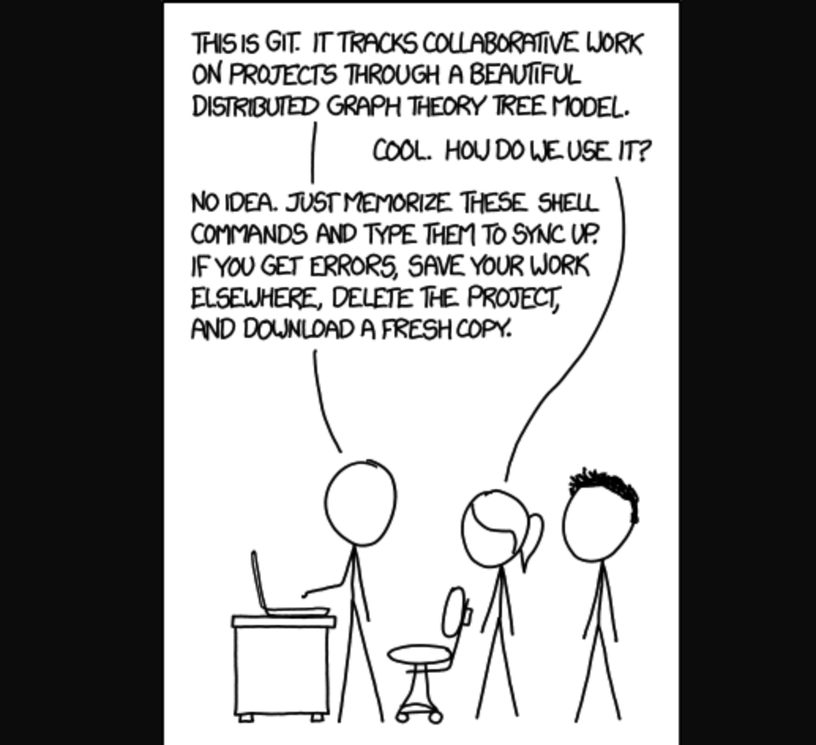
What is Git?
There is a learning curve!
Every developer has a Git disaster story to share!
xkcd

Slide 17
What is Git?
Git was designed and developed by Linus Torvalds for Linux kernel development (2005)
Git is open-source
Git works locally, on your own computer, and offline

Slide 18
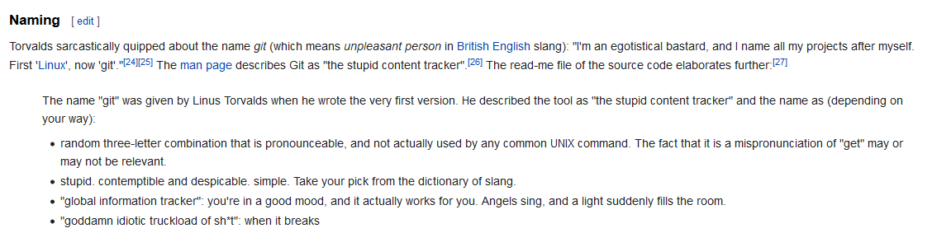
Where does the name come from?
Wikipedia

Slide 19
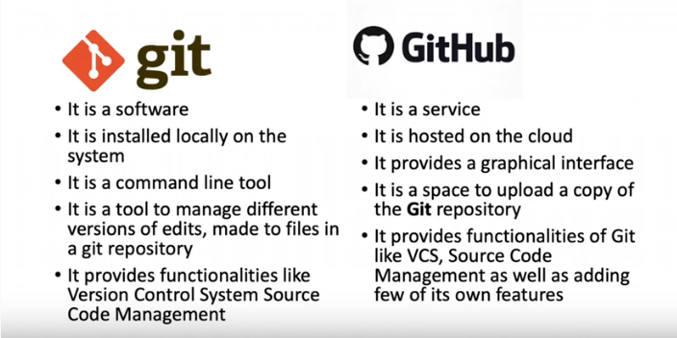
What is GitHub?
GitHub is the number one place to share code
Reference: Sara - Instructor

Slide 20
PART 3 GIT BASH / GIT IN VS CODE
30 minutes

Slide 21
GIT BASH

Slide 22
LINUX

Slide 23
Installation and configuration
Prerequisite: Git is installed
git config –-global user.email youremail
git config –-global user.name yourname
Check with git config --list

Slide 24
Scenario 1 – In the terminal
mkdir SampleApp - create new folder named SampleApp
cd SampleApp - move to the project folder
git init - initialize the repository
touch index.html - create a new file
git status - view the repository status
git add . - stage the files to commit and tell git what files to track, "." selects all the new files or files with changes
git commit index.html -m "New index file" - add the changes to the repo with the named file, "-m" indicates message included
git log – see the logs of the changes
git log –oneline - small logs
Notes:
If you do not put -m, you are stucked in vim. To get out, use :q!

Slide 25
Names of branches
The default name of the branch in git is master. You should rename it to main (used in GitHub)
After git init, do
git branch -m main
More on branches later

Slide 26
Stucked in the Vi / Vim editor
When you omit the message when you commit code, you will end up in the Vi / Vim editor to write the message
It is a good practice to put git message
To get out of Vi / Vim use:
:q!
You can configure git to use VS code instead
git config --global core.editor “code -- wait”

Slide 27
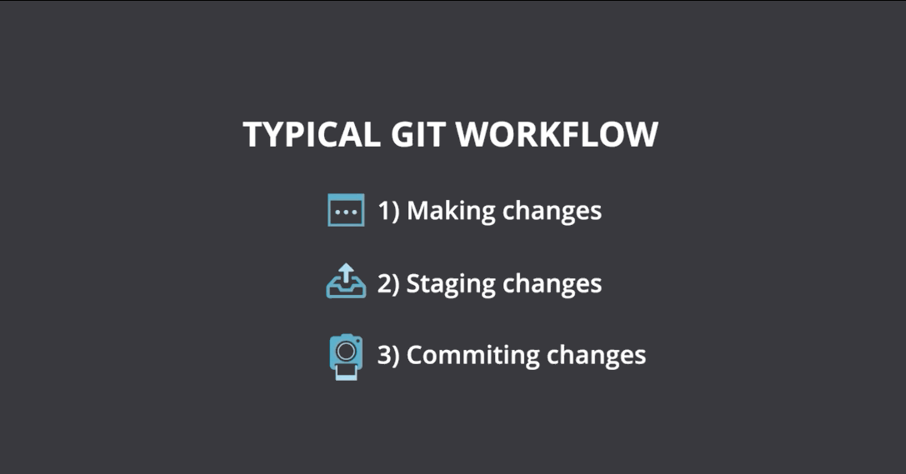

Slide 28
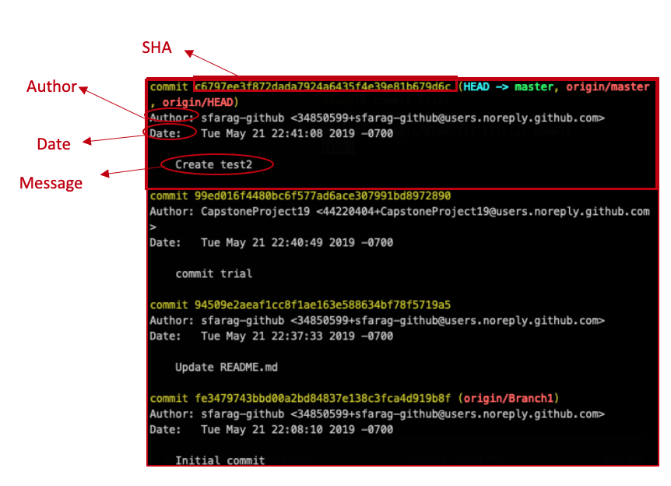
How to read Git logs?
Reference: Sara - Instructor

Slide 29
Let’s do the same in VS Code Terminal

Slide 30
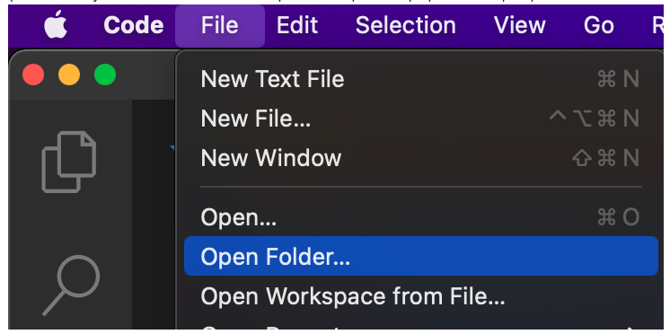
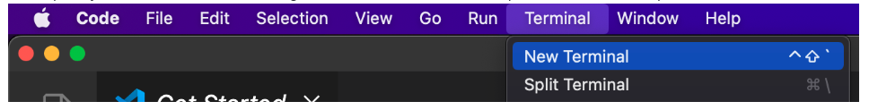

Slide 31
GIT IN VS CODE

Slide 32
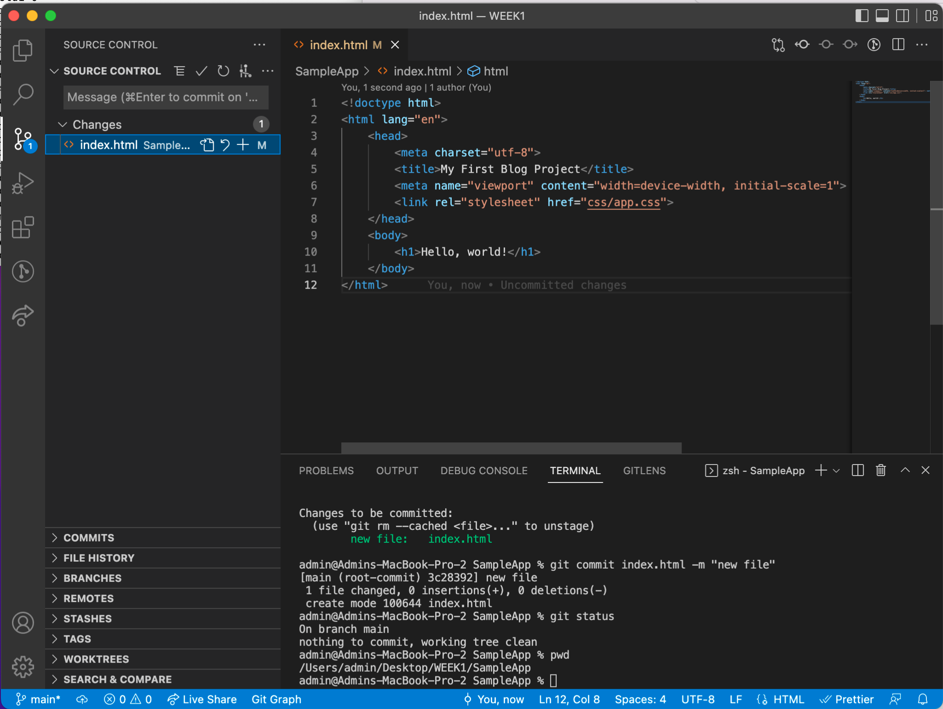
SOURCE CONTROL
In VS code. you can use the terminal, the palette or the user interface to interact with git

Slide 33
Scenario 2 – In VS Code with the palette and then the terminal
Open a project that we worked on and that is or is not tracked
Open the Palette using Cmd+Shift+P
Add source control to the project using Git:Initialize Repository
Type and select Git: stage all changes to stage changes
Look at the changes (differences) in the editor
Go to the terminal and type git status
Open the Palette again and type "Git: commit"
Go to the terminal, type git log or git log –oneline and then type git status
Go to the palette and type git log and then Git:Graph view git graph to see the tree of commits
Notes:
(Ctrl+Shift+P on PC)

Slide 34
PART 4 EXERCISE
10 minutes

Slide 35
Exercise
Start this practice by creating a new directory with mkdir
Add two files file1.html and file2.html with touch
Go to the directory with cd
Open the project in VS Code
Add the project to Git
Make some changes, stage and commit
Edit one of the files with VS code
Stage again
Use git status
View the diff
Commit
Use git status
Make more changes and go through the workflow
Post a screenshot of the result to git log to your team channel in Teams
Room discussion:
What worked?
Where did you get stuck?
How we can address trouble areas?

Slide 36
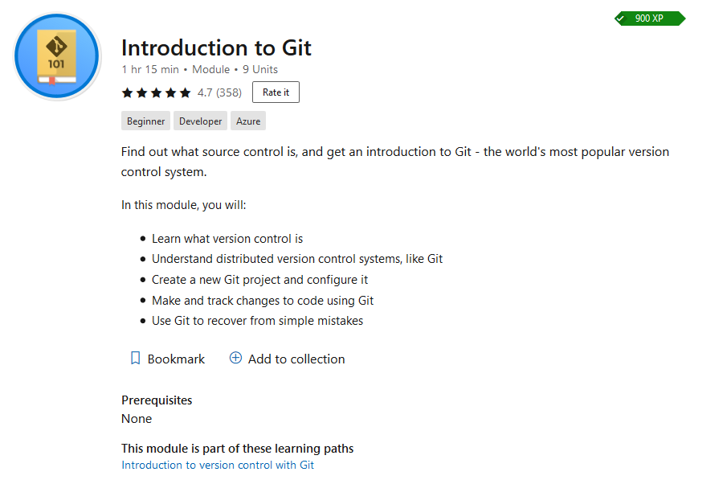
Git learning module https://docs.microsoft.com/en-us/learn/modules/intro-to-git/

Slide 37
Git Best Practices

Slide 38
Git best practices
It takes practice!
Commit often
Write good commit messages
Commit only correct code
It's good to save often and keep the change set small, it'll be easier to merge
Take a minute to review your changes before checking-in - more time will be spent on debugging, diff tools make it easier to quickly glance. Your teammates will thank you when it's time for them to review your merge request.
Use .gitignore when needed (more on this later)
What's next?
How does this actually help if it's just local on my computer? Remote repositories are next! This week practice the basics of source control on your local machine. Next, we'll dive into remote repositories, branching, pull requests, and merge conflicts.

Slide 39
PART 5 Downloading from GitHub
10 minutes

Slide 40
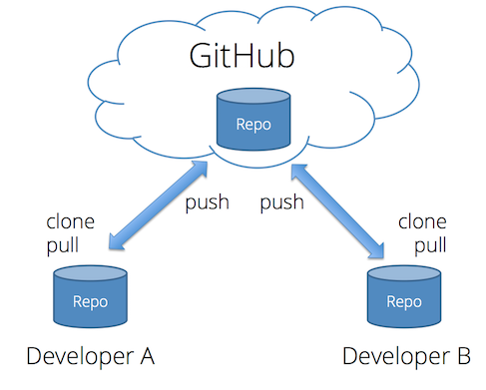
Remote repositories
https://drstearns.github.io/tutorials/git/

Slide 41
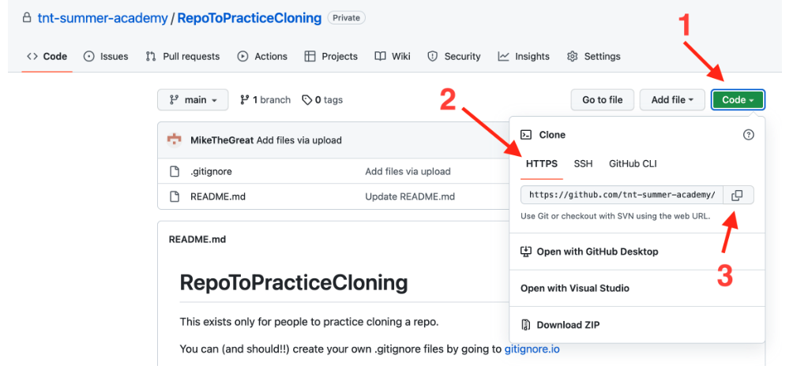
Repository from GitHub
We will use this practice repo https://github.com/tnt-summer-academy/RepoToPracticeCloning

Slide 42
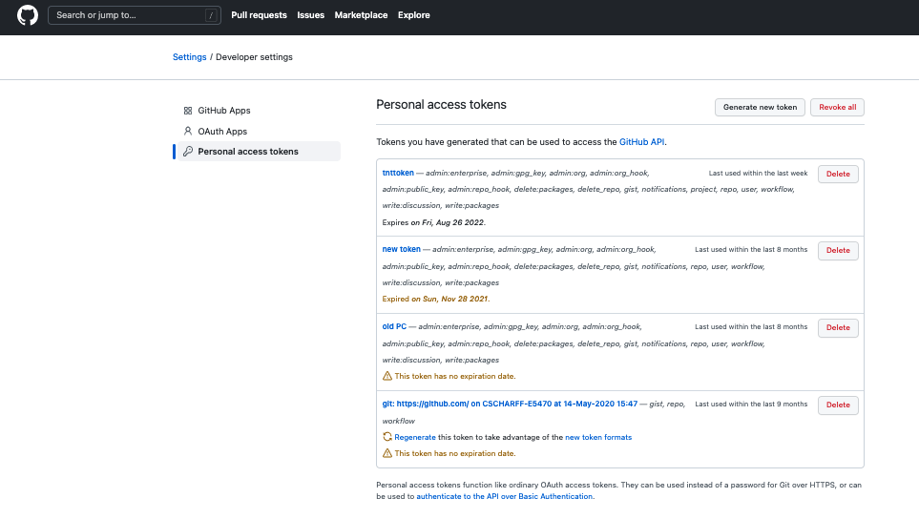
Create a personal token to access GitHub

Slide 43
Clone a repository from the terminal
We will use this practice repo https://github.com/tnt-summer-academy/RepoToPracticeCloning
git clone https://github.com/tnt-summer-academy/RepoToPracticeCloning.git

Slide 44
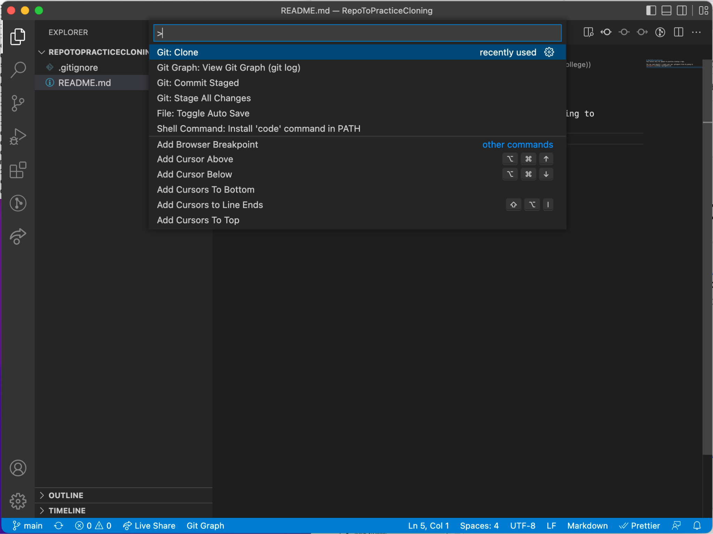
Clone a repository from GitHub using VS Code
We will use this practice repo https://github.com/tnt-summer-academy/RepoToPracticeCloning

Slide 45
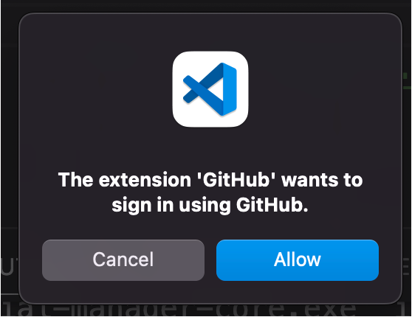
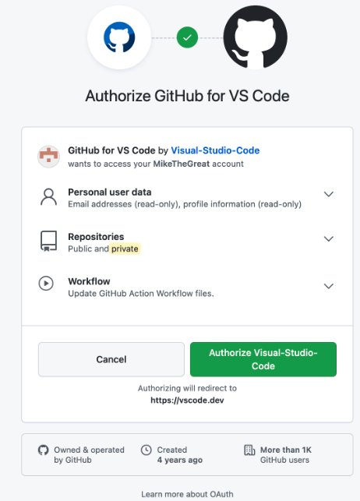
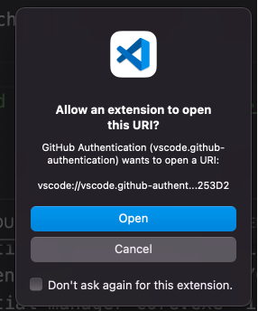
Signing into GitHub

